Slide 1
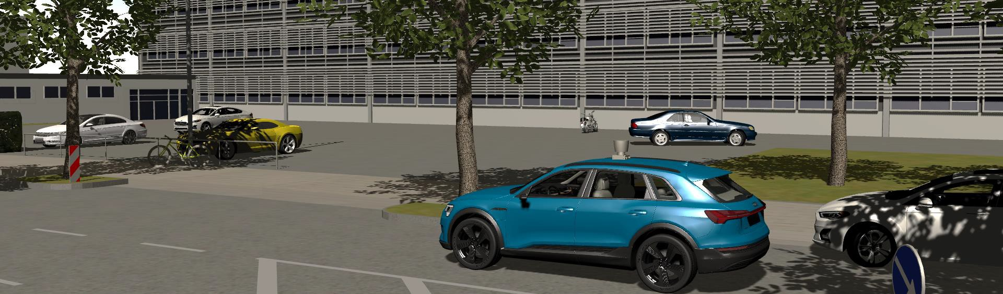
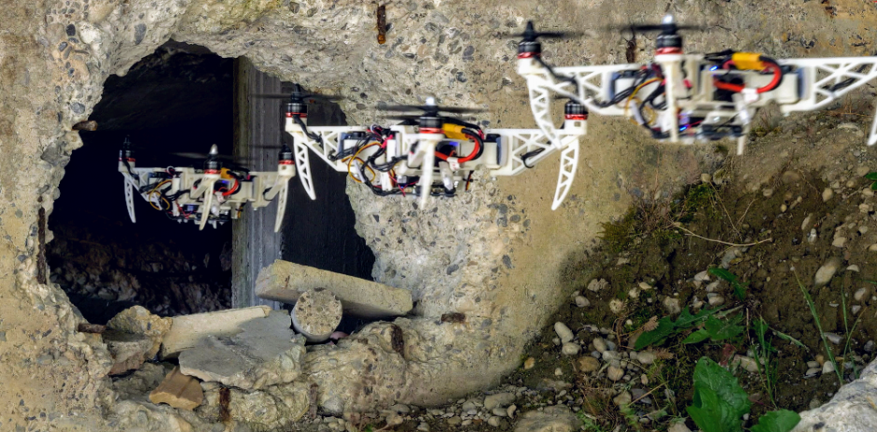
Mobile Robotics in Disaster Scenarios
Oguz Altan, 07.07.2021

Slide 2
Table of contents
Overview
Introduction
Techniques and Systems Developed for Disaster Scenarios
Examples of Mobile Robots In Disasters
Future of Mobile Robotics in Disaster Scenarios
Summary
2
Seminar: Mobile Robotics in Disaster Scenarios | 07.07.2021
Institute for Man-Machine Interaction | www.mmi.rwth-aachen.de
Oguz Altan | ouz.altan@rwth-aachen.de

Slide 3

Introduction

Slide 4
Introduction
Why Robots?
Robotics: Creating machines designed to perform tasks, traditionally performed by humans
No exhaustion, distraction, deviation
Accomplish tasks inherently impossible for humans
Lifting heavy loads
For mobile robots, different modes of controlling
Fully autonomous
Teleoperation
4
Seminar: Mobile Robotics in Disaster Scenarios | 07.07.2021
Institute for Man-Machine Interaction | www.mmi.rwth-aachen.de
Oguz Altan | ouz.altan@rwth-aachen.de
Notes:
Increase the efficiency and quality
No exhaustion, distraction, deviation from the plan
Moving in the working environment with the help of suitable components providing mobility
Getting inside a collapsed building or moving around flooded areas
By reducing the human factor and accompanying operators in the disaster scenarios, the possible harms and injuries to humans can be prevented

Slide 5
Techniques and Systems Developed for Disaster Scenarios

Slide 6
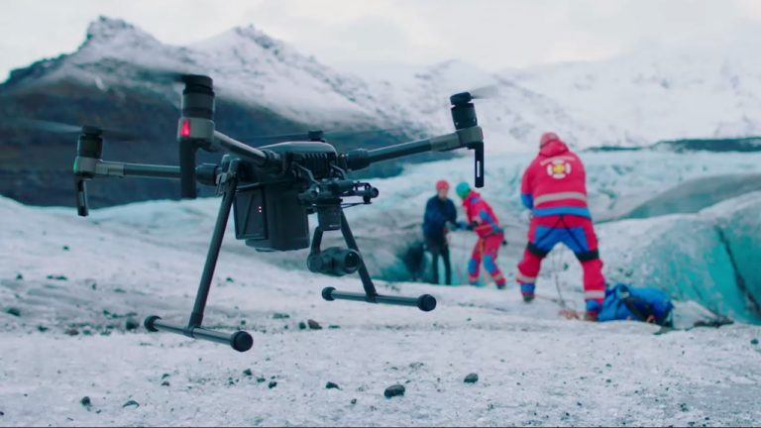
Techniques and Systems Developed for Disaster Scenarios
Main Criteria
Specialized Man-Machine Interaction
Appropriate interaction schemes for both the operator and the victims of disaster
Operating in Extreme Environment, Terrains and Conditions
Eligible equipment and design
Functioning in GPS and Wireless-Denied Areas
Poor and harsh conditions on GPS and Wireless connection
[1]
6
Seminar: Mobile Robotics in Disaster Scenarios | 07.07.2021
Institute for Man-Machine Interaction | www.mmi.rwth-aachen.de
Oguz Altan | ouz.altan@rwth-aachen.de
Notes:
Appropriate interaction schemes for both the operator behind the robot and the victims of disaster
Eligible equipment and design to overcome difficult conditions in disaster areas
Operating under poor and harsh conditions on GPS and Wireless connection

Slide 7
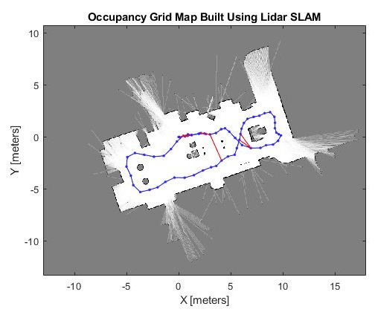
Techniques and Systems Developed for Disaster Scenarios
Unmanned Ground Vehicle (UGV)
Simultaneous Localization and Mapping (SLAM)
Initially unknown environment
Indoor applications
Maps are formed using LiDAR data
Estimating the robot’s pose and the map of the environment using the sensor observation and control data
[2]
7
Seminar: Mobile Robotics in Disaster Scenarios | 07.07.2021
Institute for Man-Machine Interaction | www.mmi.rwth-aachen.de
Oguz Altan | ouz.altan@rwth-aachen.de
Notes:
Enabling rescuers to find and interact with victims who are trapped in challenging environments
Disaster areas are often difficult and challenging as they can be too small or too dangerous for humans to intervene
Estimating the robot’s pose and the map of the environment at the same time

Slide 8
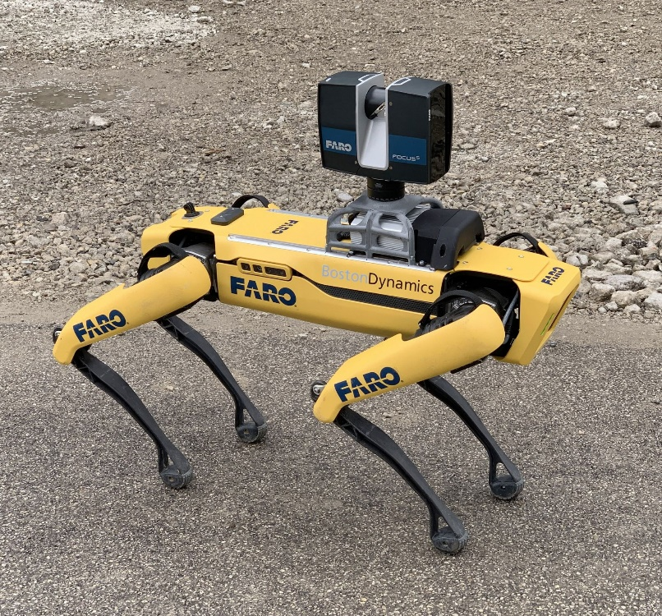
Techniques and Systems Developed for Disaster Scenarios
Unmanned Ground Vehicle (UGV)
Electronic Payload
Global navigation satellite system (GNSS)
Inertial measurement unit (IMU)
Light detection and ranging (LIDAR) sensors
Camera(s) for computer vision applications
Providing visibility
Detecting victims
Avoiding obstacles
[3]
8
Seminar: Mobile Robotics in Disaster Scenarios | 07.07.2021
Institute for Man-Machine Interaction | www.mmi.rwth-aachen.de
Oguz Altan | ouz.altan@rwth-aachen.de
Notes:
Providing visibility of the area

Slide 9
Techniques and Systems Developed for Disaster Scenarios
Unmanned Ground Vehicle (UGV)
Locomotion Systems
Legs
Three legged system, easy to control and straightforward kinematic
Four legged system, more stable and higher safety for payload
Track
Higher grip on terrain, easier to navigate over obstacles
Slow steering
Wheels
Move easily on flat ground
Inefficient at rovering and navigating on obstacles
9
Seminar: Mobile Robotics in Disaster Scenarios | 07.07.2021
Institute for Man-Machine Interaction | www.mmi.rwth-aachen.de
Oguz Altan | ouz.altan@rwth-aachen.de

Slide 10
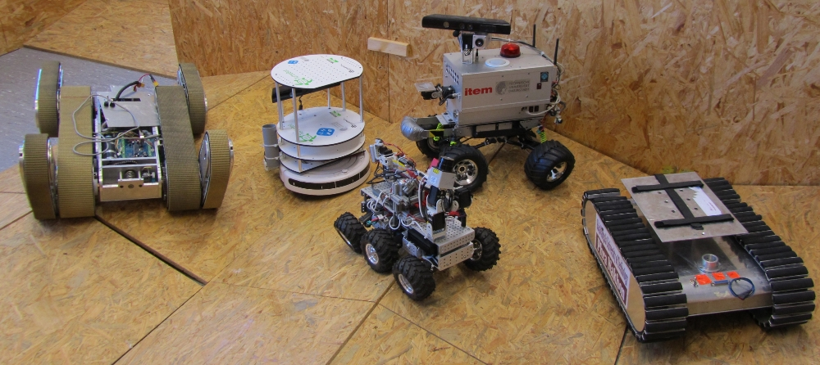
Techniques and Systems Developed for Disaster Scenarios
Unmanned Ground Vehicle (UGV)
Technical University of Darmstadt’s Team HECTOR
10
Seminar: Mobile Robotics in Disaster Scenarios | 07.07.2021
Institute for Man-Machine Interaction | www.mmi.rwth-aachen.de
Oguz Altan | ouz.altan@rwth-aachen.de

Slide 11
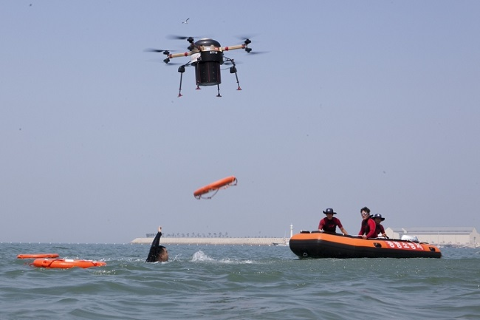
Techniques and Systems Developed for Disaster Scenarios
Unmanned Aerial Vehicle (UAV), also known as Drone
Victim Search
Scanning large areas using built-in cameras and image systems
Delivery
Food, water, medical supplies and communication devices to the victims
Mapping and Sectorization
Stream real-time images/videos of disaster scene
[4]
11
Seminar: Mobile Robotics in Disaster Scenarios | 07.07.2021
Institute for Man-Machine Interaction | www.mmi.rwth-aachen.de
Oguz Altan | ouz.altan@rwth-aachen.de
Notes:
Scanning large areas using built-in cameras and image systems, detecting possible victim locations
Useful and vital items such as food, water, medical supplies and communication devices to the victims
Stream real-time images/videos of disaster scene landscape to operators over a long period of time

Slide 12
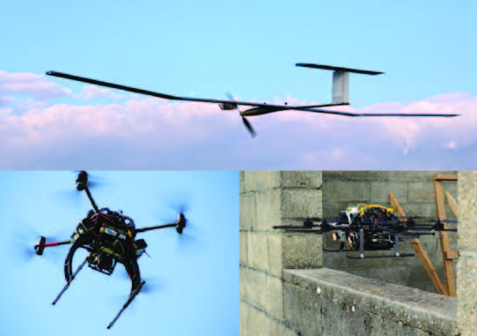
Techniques and Systems Developed for Disaster Scenarios
Unmanned Aerial Vehicle (UAV)
Fixed-wing Drones
Airplane-like design
Reckoning, scanning and mapping of the area
When signal lost, returns home using GPS waypoint navigation technology
Rotary-wing Drones
Eg. helicopters and quadrocopters
Indoors, near structures and in small areas
Small details can be detected at low altitudes
12
Seminar: Mobile Robotics in Disaster Scenarios | 07.07.2021
Institute for Man-Machine Interaction | www.mmi.rwth-aachen.de
Oguz Altan | ouz.altan@rwth-aachen.de

Slide 13
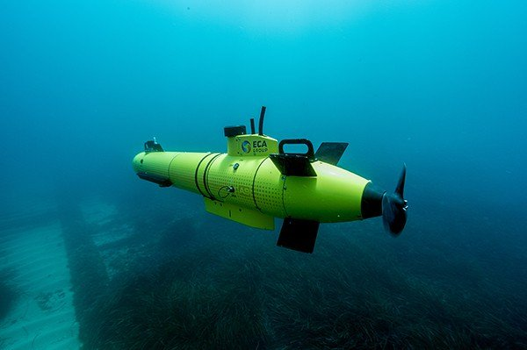
Techniques and Systems Developed for Disaster Scenarios
Unmanned Marine Vehicle (UMV)
Autonomous Underwater Vehicle (AUV)
Independent of any tether or teleoperated system, fully autonomous
Acoustic imaging sensors, cameras and sonars
Dead reckoning
Determine the position using the vehicle’s past data, without the aid of any external navigation system
13
Seminar: Mobile Robotics in Disaster Scenarios | 07.07.2021
Institute for Man-Machine Interaction | www.mmi.rwth-aachen.de
Oguz Altan | ouz.altan@rwth-aachen.de
Notes:
Acoustic imaging sensors, cameras, sonar sensors for mapping, navigating and sensing under the water
Determine the position using the vehicle’s past data such as routes traveled or flown, velocity and distance traveled, known starting point of the vehicle and known or estimated drift, without the aid of any external navigation system

Slide 14
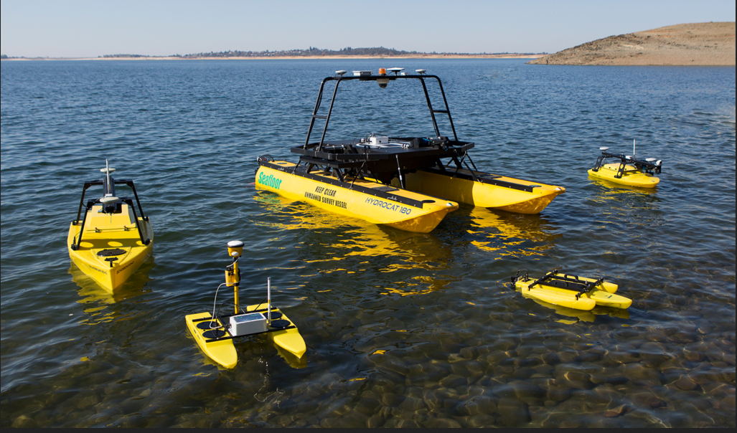
Techniques and Systems Developed for Disaster Scenarios
Unmanned Marine Vehicle (UMV)
Remotely Operated Vehicle (ROV)
Teleoperated via a tether
Real-time data stream
Power for sensors, motors and other electronic loads
Unmanned Surface Vehicle (USV)
Operates on the surface
No need for tether, can move freely
Strong GPS and Wireless connection
14
Seminar: Mobile Robotics in Disaster Scenarios | 07.07.2021
Institute for Man-Machine Interaction | www.mmi.rwth-aachen.de
Oguz Altan | ouz.altan@rwth-aachen.de

Slide 15
Examples of Mobile Robots In Disasters

Slide 16
Examples of Mobile Robots In Disasters
World Trade Center 9/11 Disaster
Identify and rescue survivors trapped under the rubble
Robots were either lost or crashed
Loss of wireless communication signal, thick walls and a large amount of wreckage
Tethers broke at some point
Key lessons
Connected safety line
Fast movement and sneak into small spaces
16
Seminar: Mobile Robotics in Disaster Scenarios | 07.07.2021
Institute for Man-Machine Interaction | www.mmi.rwth-aachen.de
Oguz Altan | ouz.altan@rwth-aachen.de
Notes:
Identify and rescue survivors trapped under the rubble, in the stairwells and basements of the twin towers
Tethers broke at some point and therefore robot could not be retrieved
Every robot in the disaster area, whether wired or wireless communication, must have a connected safety line
Robot platforms, preferably small in size, suitable for fast movement and able to sneak into small spaces and under wreckage
At least a color camera and audio system

Slide 17
Examples of Mobile Robots In Disasters
Fukushima Daiichi Nuclear Disaster
Massive earthquake followed by a tsunami
Nuclear meltdowns and hydrogen explosions
Extremely harmful, high radiation and aftershocks
Upgrade and retrofit Quince
Mobility, radiation hardness, communications, hardware reliability
Dosimeter, pan-tilt-zoom camera, LED lights and temperature sensors
17
Seminar: Mobile Robotics in Disaster Scenarios | 07.07.2021
Institute for Man-Machine Interaction | www.mmi.rwth-aachen.de
Oguz Altan | ouz.altan@rwth-aachen.de
Notes:
Extremely harmful for human operators to work in the field due to possible high radiation and aftershocks

Slide 18
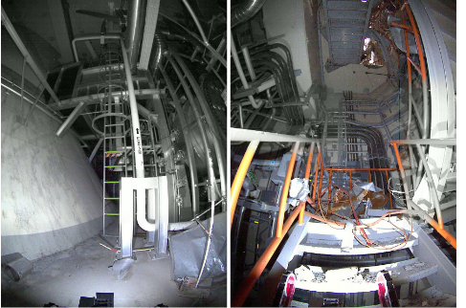
Examples of Mobile Robots In Disasters
Fukushima Daiichi Nuclear Disaster
Failures
Robots got stuck, unable to move
Communication cables got snagged
High temperature, robots automatically shut itself
Key lessons
Accurate and detailed communication between researchers and users
Operators have to be well trained
18
Seminar: Mobile Robotics in Disaster Scenarios | 07.07.2021
Institute for Man-Machine Interaction | www.mmi.rwth-aachen.de
Oguz Altan | ouz.altan@rwth-aachen.de
Notes:
Communication cables got snagged on the pipes and communication was lost
Operators have to be well trained on how to use robots in disasters
Researchers have to become familiar with the various technologies used in mobile robots

Slide 19
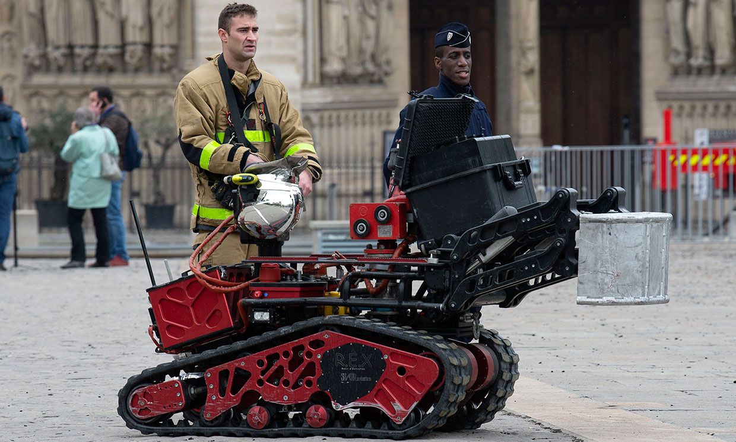
Examples of Mobile Robots In Disasters
Notre-Dame de Paris Fire
Colossus robot, assisted the Paris Firefighter Brigade
Teleoperated by trained operators
Fully waterproof and high temperature resistant chassis
Carry heavy equipment to firefighters, clear debris and navigate through dangerous areas
19
Seminar: Mobile Robotics in Disaster Scenarios | 07.07.2021
Institute for Man-Machine Interaction | www.mmi.rwth-aachen.de
Oguz Altan | ouz.altan@rwth-aachen.de
Notes:
Colossus robot, assisted the Paris Firefighter Brigade in extinguishing the fire

Slide 20
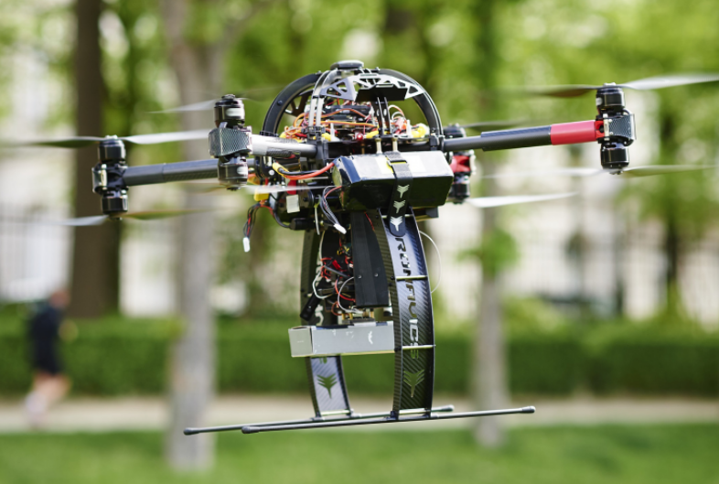
Examples of Mobile Robots In Disasters
ICARUS
The European Union’s Integrated Components for Assisted Rescue and Unmanned Search operations (ICARUS) project, 2012-2016
Main purposes
Develope a light sensor capable of detecting humans
Self-organizing cognitive wireless communication network
Heterogeneous robot collaboration between unmanned search and rescue vehicles
[5]
20
Seminar: Mobile Robotics in Disaster Scenarios | 07.07.2021
Institute for Man-Machine Interaction | www.mmi.rwth-aachen.de
Oguz Altan | ouz.altan@rwth-aachen.de
Notes:
took place between 2012 and 2016

Slide 21
Future of Mobile Robotics in Disaster Scenarios

Slide 22
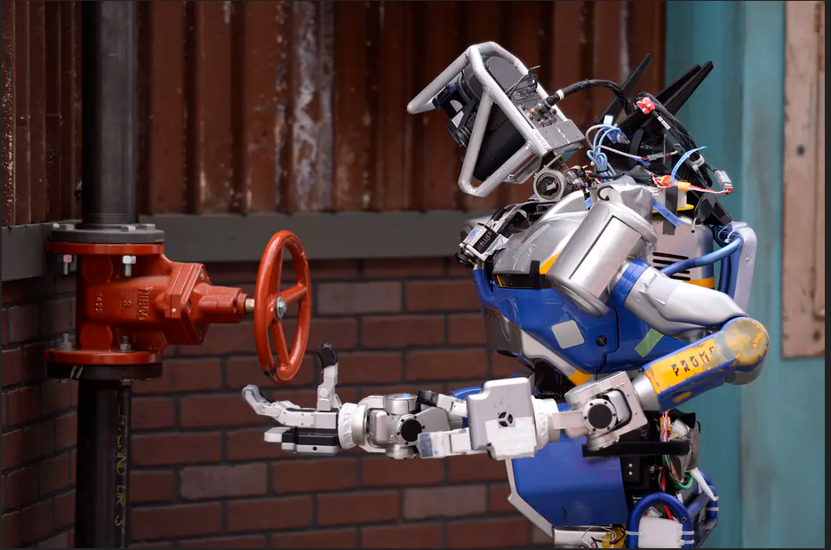
Future of Mobile Robotics in Disaster Scenarios
Search and Rescue Robotics Competitions
DARPA Robotics Challenge
Robots earn points as they perform various tasks related to various disaster scenarios
Not only in earthquakes but also in nuclear emergencies, fires, floods, chemical spills, and other natural and man-made disasters
22
Seminar: Mobile Robotics in Disaster Scenarios | 07.07.2021
Institute for Man-Machine Interaction | www.mmi.rwth-aachen.de
Oguz Altan | ouz.altan@rwth-aachen.de
Notes:
Promotes progress in artificial intelligence in mobile robotics, high mobility and dexterity, as well as safety and effectiveness of the emergency process

Slide 23
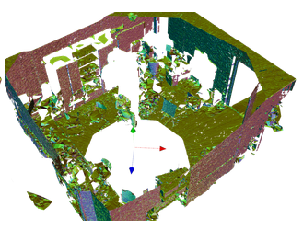
Future of Mobile Robotics in Disaster Scenarios
Trending Research Topics and Future Solutions
Sensors
Developing compact and durable sensors
Sensing algorithms and valuable data generation
Mapping, Localization and Vision
Three-dimensional (3-D) simultaneous localization and mapping
Mechanical Design, Mobility and Controllers
Fuzzy logic controllers and deep learning powered neural controllers
[6]
23
Seminar: Mobile Robotics in Disaster Scenarios | 07.07.2021
Institute for Man-Machine Interaction | www.mmi.rwth-aachen.de
Oguz Altan | ouz.altan@rwth-aachen.de
Notes:
Fuzzy logic controllers and deep learning powered neural controllers providing robust and fast navigation

Slide 24
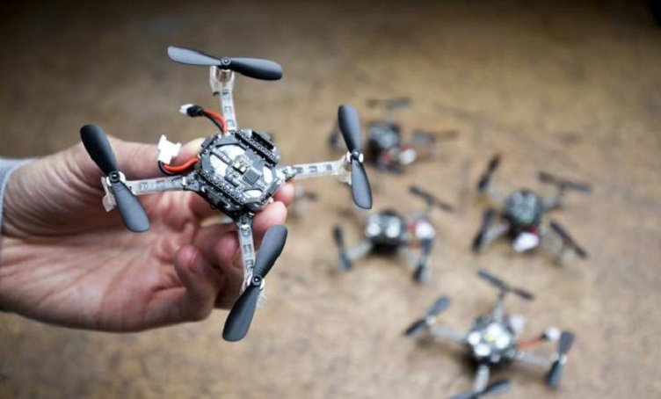
Future of Mobile Robotics in Disaster Scenarios
Trending Research Topics and Future Solutions
Power Systems
Lithium ion polymer (Li-Po) batteries
Solar cells
Communications
Integrating 5G into mobile robotics
Man-Machine Interaction (MMI)
Decrease human-to-robot ratio
Swarm behavior and intelligence for multiple mobile robots
Affective computing
24
Seminar: Mobile Robotics in Disaster Scenarios | 07.07.2021
Institute for Man-Machine Interaction | www.mmi.rwth-aachen.de
Oguz Altan | ouz.altan@rwth-aachen.de
Notes:
Swarm behavior and intelligence for multiple mobile robots, increasing autonomy and complete various tasks shared intelligence
Affective computing, creating robots that can recognize, understand, interpret and sense human affects

Slide 25
Summary

Slide 26
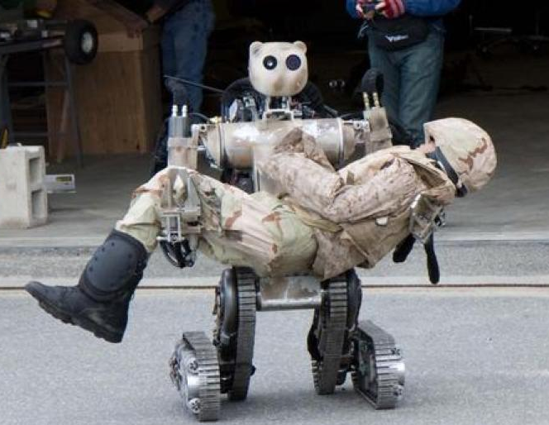
Summary
Mobile robotics is a multidisciplinary branch of robotics involving engineering, mathematics, design, psychology, neuroscience and many more
Unmanned ground, aerial and marine vehicles
9/11 Disaster, Fukushima Daiichi Nuclear Disaster and the Notre-Dame de Paris Fire
Competitions around the world to develop mobile robotics
Mobile robots open to development and hence trending hot topics
[7]
26
Seminar: Mobile Robotics in Disaster Scenarios | 07.07.2021
Institute for Man-Machine Interaction | www.mmi.rwth-aachen.de
Oguz Altan | ouz.altan@rwth-aachen.de
Notes:
According to the medium of operation: unmanned ground vehicle (UGV), unmanned aerial vehicle (UAV) and unmanned marine vehicle (UMV)
The World Trade Center 9/11 Disaster, Hurricane Katrina, Fukushima Daiichi Nuclear Disaster and the Notre-Dame de Paris Fire are disasters that mobile robotics that had an essential role in various tasks
Various subsystems of the mobile robots open to development and hence hot topics in mobile robotics in disaster scenarios

Slide 27
Thank you
for your attention

Slide 28
References
References:
[1] “Drones for Search and Rescue,” COPTRZ, 05-May-2020. [Online]. Available: https://coptrz.com/drone-in-sar-operations/. [Accessed: 06-Jul-2021].
[2] “What Is SLAM (Simultaneous Localization and Mapping) – MATLAB & Simulink,” What Is SLAM (Simultaneous Localization and Mapping) – MATLAB & Simulink - MATLAB & Simulink. [Online]. Available: https://www.mathworks.com/discovery/slam.html. [Accessed: 06-Jul-2021].
[3] “FARO and Boston Dynamics announce Trek integration for automated 3D scanning,” Geo Week News. [Online]. Available: https://www.geoweeknews.com/news/faro-and-boston-dynamics-announce-trek-integration-for-automated-3d-scanning. [Accessed: 06-Jul-2021].
[4] By and K. Bizwire, “Drones to the Rescue: Next-Generation Lifeguards Can Fly,” Be Korea-savvy, 18-Jul-2017. [Online]. Available: http://koreabizwire.com/drones-to-the-rescue-next-generation-lifeguards-can-fly/88780. [Accessed: 06-Jul-2021].
28
Seminar: Mobile Robotics in Disaster Scenarios | 07.07.2021
Institute for Man-Machine Interaction | www.mmi.rwth-aachen.de
Oguz Altan | ouz.altan@rwth-aachen.de

Slide 29
References
References:
[5] “ICARUS makes first-ever legal RPAS flight in Brussels,” FP7. [Online]. Available: http://www.fp7-icarus.eu/news/icarus-makes-first-ever-legal-rpas-flight-brussels. [Accessed: 06-Jul-2021].
[6] Voxel Planes - IROS 2013. [Online]. Available: http://www-personal.umich.edu/~dhiman/voxelplanes/presentation.html#3. [Accessed: 06-Jul-2021].
[7] “Slideshow: Rescue Robots Save the Day,” designnews.com, 21-May-2017. [Online]. Available: https://www.designnews.com/slideshow-rescue-robots-save-day/gallery?slide=1. [Accessed: 06-Jul-2021].
29
Seminar: Mobile Robotics in Disaster Scenarios | 07.07.2021
Institute for Man-Machine Interaction | www.mmi.rwth-aachen.de
Oguz Altan | ouz.altan@rwth-aachen.de

